Slide 1
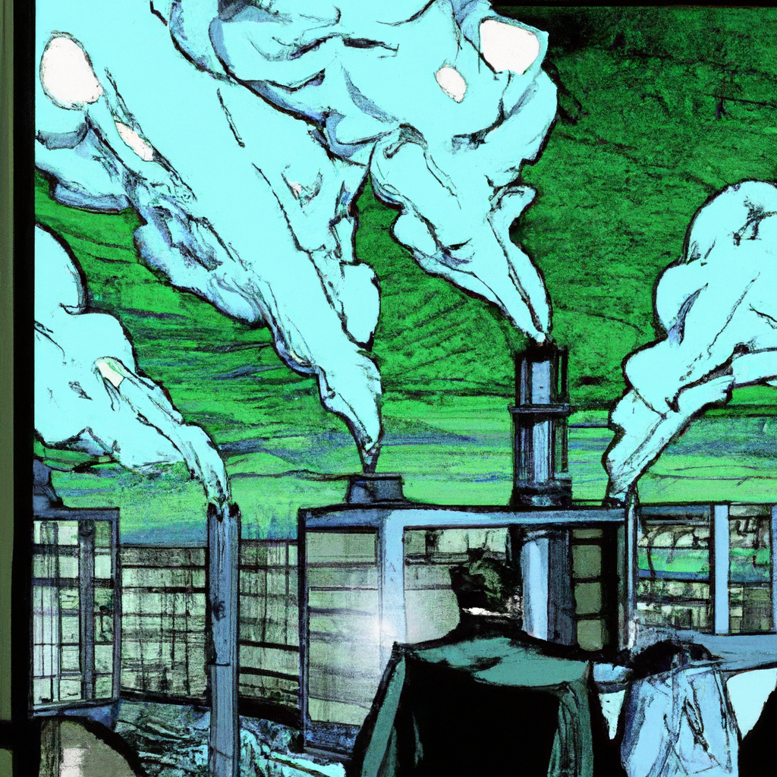
"Unveiling the Mysterious Operations of ToxinCorp Industries: A Night in Gotham City"
Slide Title: Unseen Shadows of Gotham
Scene: Picture an industrial landscape bathed in an eerie moonlight. Thick, black smoke is rising from giant smokestacks belonging to ToxinCorp Industries. The factories are sprawling, filled with large machines, and workers shrouded in hazmat suits. Green chemicals pour from vats, filling up canisters. Steam fills the air. In the distance, trucks loaded with canisters are heading out of the factories.
Dialogue Box 1 (Worker in hazmat suit): "Another batch of green ooze ready for transport."
Dialogue Box 2 (Second Worker in hazmat suit): "Business as usual at ToxinCorp."
Cut to: An office overlooking this industrial scene. The manager sits in his chair, fingers crossed, a sinister smirk on his face.
Dialogue Box 3 (ToxinCorp Manager): "With every canister, Gotham inches closer to its destiny. And no one, not even Batman, can stop it."
Caption: To be Continued...
Slide Note: This scene explores the potentially nefarious activities of ToxinCorp Industries and sets a stage for escalating conflict in Gotham city.

Slide 2
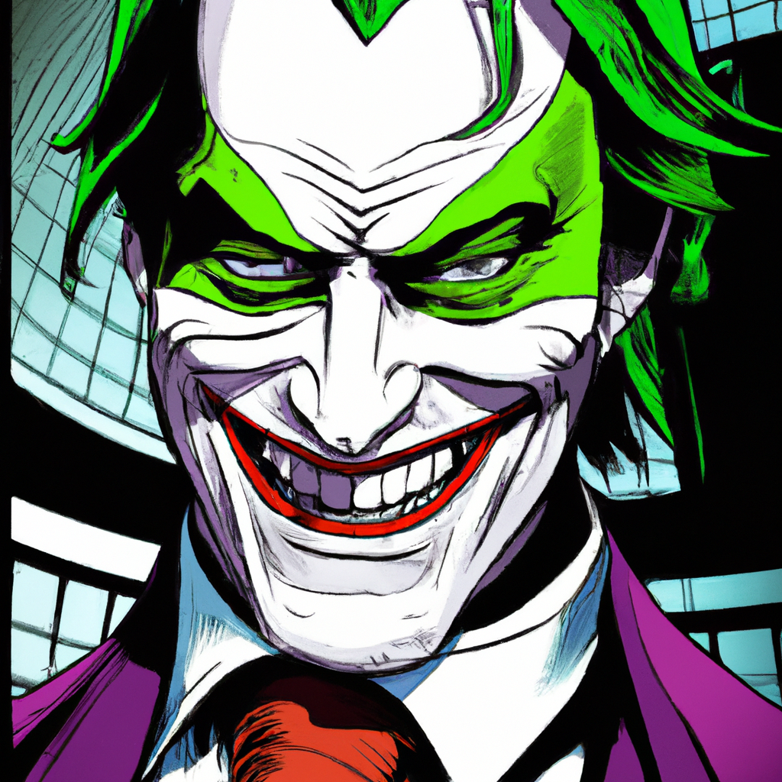
"The Dark Underbelly of Gotham: The Joker's Reign and the ToxinCorp Empire"
Slide Header: The Joker's Reign
Slide Image: A gloomy overhead view of Gotham city with ToxinCorp's emblem and Wayne Enterprises logo in the foreground. The Joker, with his menacing smirk, is superimposed in the background towering over the cityscape.
Slide Text:
Narrator: "Dreaded by many as 'the boss', known to a few as 'Jack' or 'Arthur', he ruled Gotham from the shadows. The Joker, a rogue of infamy, mastermind of countless crimes."
Image Caption: "The Joker, an ever-present terror in the heart of Gotham."
Narrator: "From the gloomy walls of Arkham Asylum and the towers of ToxinCorp, his grip on Gotham remained unyielding. ToxinCorp, supplying Gotham's chemical needs, rendered the city unwittingly dependent on its most feared menace."
Image Caption: "Gotham under the shadow of The Joker's ToxinCorp."
Joker's Dialogue: "Beautiful, isn't it? My reign remains unchallenged. Not even Batman can topple me. Yet, I can sense another round of our dance. I can hardly wait."
Image Caption: "The Joker, savoring his reign over Gotham."
Slide Footer: The Joker's Monarchy: Unchallenged, Unyielding, and Unpredictable.

Slide 3
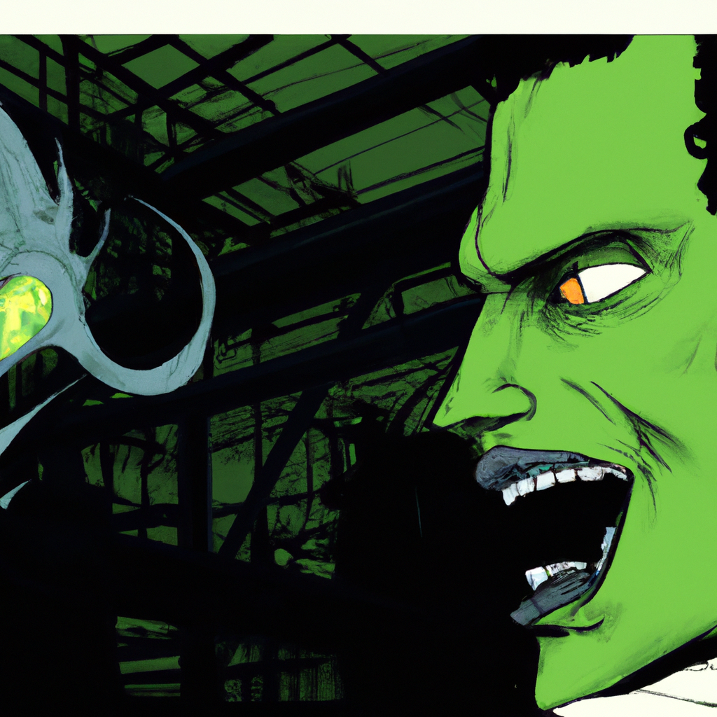
"Encounter with the Unknown: A Nightmarish Alien Encounter at Power Station"
Slide 1:
The frame shows a worker, a hard hat on his head, standing in an urban landscape across the street from a towering factory. His hand is on his hip, a cellphone pressed to his ear. The speech bubble next to him reads: "Alright, power's on its way. The factory should be humming in no time."
Slide 2:
The next frame shows the worker, now looking confused and a little afraid, his eyes wide as he hangs up the phone. He's staring at the factory wall, where an odd, eerie shadow stretches. The dialogue box says: "What in the world...?"
Slide 3:
This frame focuses on the shadow, revealing its monstrous shape. A chilling growl is written in big, bold letters. The worker's terrified speech bubble says, "Who's there?!"
Slide 4:
The frame then flips to show a close-up of the worker's horrified face as he turns around. His eyes are wide, his face pale. The caption reads: "A horror unlike any other... an alien with monstrous teeth, sinister white eyes and green goo-colored skin with dark spots..."
Slide 5:
Now, the frame shows the alien, its tendrils rising menacingly from its back as it lunges at the worker. The worker's scream is represented by the word "AAAAAHHH!" in bold, jagged letters.
Slide 6:
The final frame is a wide shot of the factory, the worker's scream echoing in the night. The caption below reads: "The scream echoed into the night, accompanying the sound of flesh being torn, and green goo splattered upon the wall..." The scene shows splatters of green goo on the factory wall, making a chilling and horrifying cliffhanger.

Slide 4
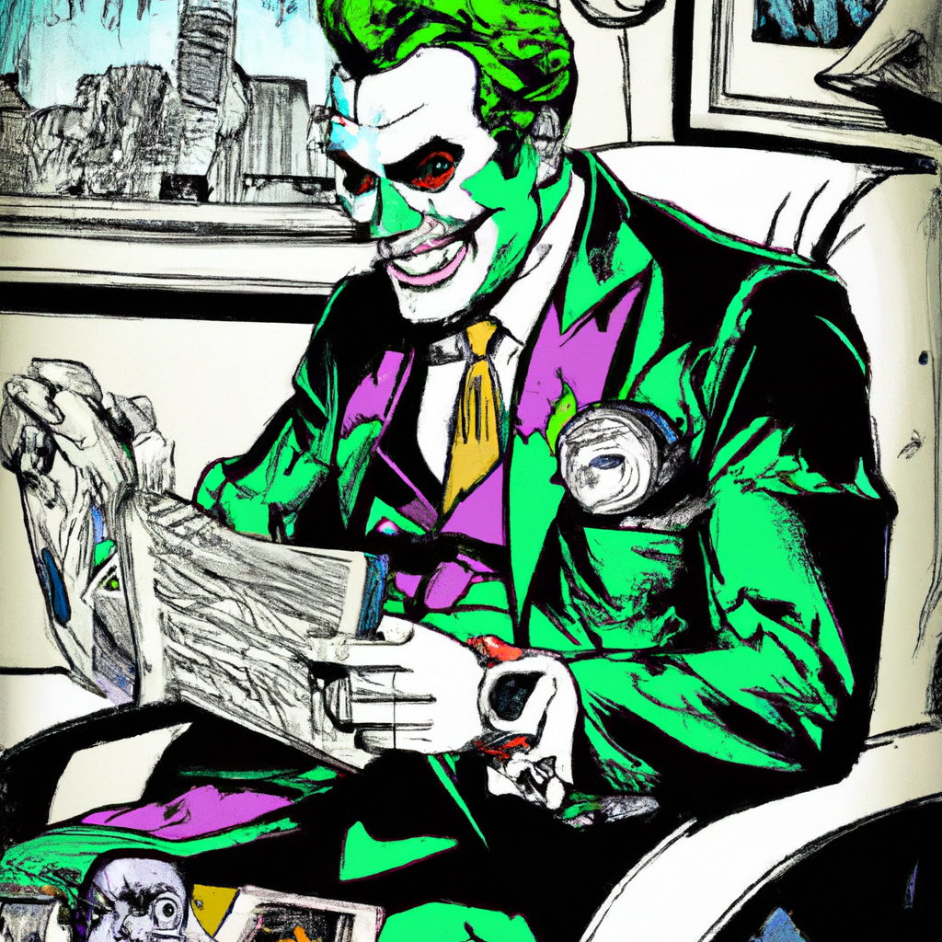
"Exploring Joker's Relationships and Perspectives on Fellow Villains"
Panel 1:
[Image: The Joker checks his watch, a smirk dancing on his lips. The clock on the wall can also be seen in the background.]
Caption: "In his office, The Joker checks his watch against the wall clock..."
Joker's Dialogue: "Running late are we, Bat?"
Panel 2:
[Image: Joker's eyes narrow, focusing on a photo of Batman. His smirk widens.]
Caption: "...He smirks maliciously at a photo of the Dark Knight, imagining their next encounter."
Joker's Dialogue: "Can't wait for our next dance, Batsy..."
Panel 3:
[Image: Joker's eyes wander, reminiscing about past alliances. Images of The Penguin, The Riddler, and Clayface are scattered on his desk.]
Caption: "Memories of past alliances flood his mind..."
Joker's Dialogue: "Ah, the good ol' times with Oswald...Nygmie's riddles...and Clayface."
Panel 4:
[Image: Joker's face scrunches up in disgust, thinking about the villains he could never stand. An image of The Red Skull is visible.]
Caption: "But there are some villains that even The Joker can't stand..."
Joker's Dialogue: "Partnering with Red Skull? Over my dead body!"

